Slide 1
Entropy Information Compression
Alex Dimakis UT Austin

Slide 2
Entropy: How to measure information
Rain in Seattle: Say each day we flip a coin and it rains with 80% probability, independently.
We observe a sequence of 100 days: 110101011011101111010111…101111
Q: How much information is there in this sequence?
Not 100 bits ?
How much can we compress it?
Shannon’s compression theorem: Entropy is the ultimate limit to compression

Slide 3
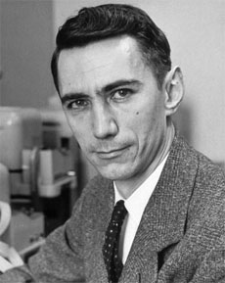
Setup for Shannon’s compression theorem
Alan
Claude
First they meet before and they know the statistics of rain but not the realization.
They agree on some compression scheme: When I see 1111, I will send 01, otherwise I will send 10 followed by the weather in the next 5 days. …

Slide 4

Setup for Shannon’s compression theorem
1101110110…
Alan
011010
1101110110…
Claude

Slide 5
Always Rain = 0 information=compressible to 0 bits
11111111111
Alan
duh
1111111111
Claude

Slide 6
Entropy is the limit to compression
H(Rain) = - [ p log (p) + (1-p) log (1-p) ]
If p= 0, H(Never Rain) = - [ 0 log0 + 1*log1] = 0 bits. (perfectly compressible)
if p=1, H(Always Rain)= -[1 log1 + 0 log0]= 0 bits (perfectly compressible)
if p=0.8 H(Rain) = -[0.8 log0.8 + 0.2* log 0.2] = 0.7219… bits per day
Shannon’s compression theorem: we can compress 100 bits of rain data into 73 bits
if p=0.9, H(Rain) = 0.468.., so we can further compress 100 bits of rain data into 47 bits. Less surprise= Less information= more compression.
Only when p=1/2 (fair coin) we have maximum surprise = maximum information = no compression is possible.
H( fair coin ) =1 bit per realization.
Use log base 2. Also set 0 log0 = 0 , by continuity.

Slide 7
Intuitive understanding of the compression theorem
Fact 1: To describe one object in a list of L things, I need Log L bits

Slide 8
Intuitive understanding of the compression theorem
Fact 1: To describe one object in a list of L things, I need Log L bits
L= 4
Banana
Orange
Apple
Mango

Slide 9
Intuitive understanding of the compression theorem
Fact 1: To describe one object in a list of L things, I need Log L bits
L= 4
Banana 00
Orange 01
Apple 10
Mango 11
Alan
Claude

Slide 10
Intuitive understanding of the compression theorem
Fact 1: To describe one object in a list of L things, I need Log L bits
Fact 2: When compressing random sequences, there are only a few sequences you need to represent. Only those will appear with very high probability. We call them typical sequences.
We only need Log ( number of typical sequences) bits to compress and succeed with high probability.
See Cover and Thomas ‘Elements of Information Theory’ for details

Slide 11
Intuitive understanding of the compression theorem
When I flip a coin 100 times with p=0.10 I expect to see about 10 heads.
Alan and Claude will only worry about representing those sequences with exactly 10 heads. If it rains fewer or more than 10 times in 100 days they will declare failure.
How many ways are there to place 10 sunny days in 100 positions?

Slide 12
Intuitive understanding of the compression theorem
When I flip a coin 100 times with p=0.10 I expect to see about 10 heads.
Alan and Claude will only worry about representing those sequences with exactly 10 heads. If it rains fewer or more than 10 times in 100 days they will declare failure.
How many ways are there to place 10 sunny days in 100 positions?
How about placing 90 sunny days in 100 positions?

Slide 13
Intuitive understanding of the compression theorem
When I flip a coin 100 times with p=0.10 I expect to see about 10 heads.
Alan and Claude will only worry about representing those sequences with exactly 10 heads. If it rains fewer or more than 10 times in 100 days they will declare failure.
How many ways are there to place 10 sunny days in 100 positions?

Slide 14
Intuitive understanding of the compression theorem
Fact 1: To describe one object in a list of L things, I need Log L bits
Fact 2: When compressing random sequences, there are only a few sequences you need to represent. Only those will appear with very high probability. We call them typical sequences.
We only need Log ( number of typical sequences) bits to compress and succeed with high probability.
Entropy of any random variable is essentially equal to the logarithm of the number of typical sequences. (Asymptotic Equipartition Property).
This is essentially the Law of Large numbers.
See Cover and Thomas ‘Elements of Information Theory’ for details

Slide 15
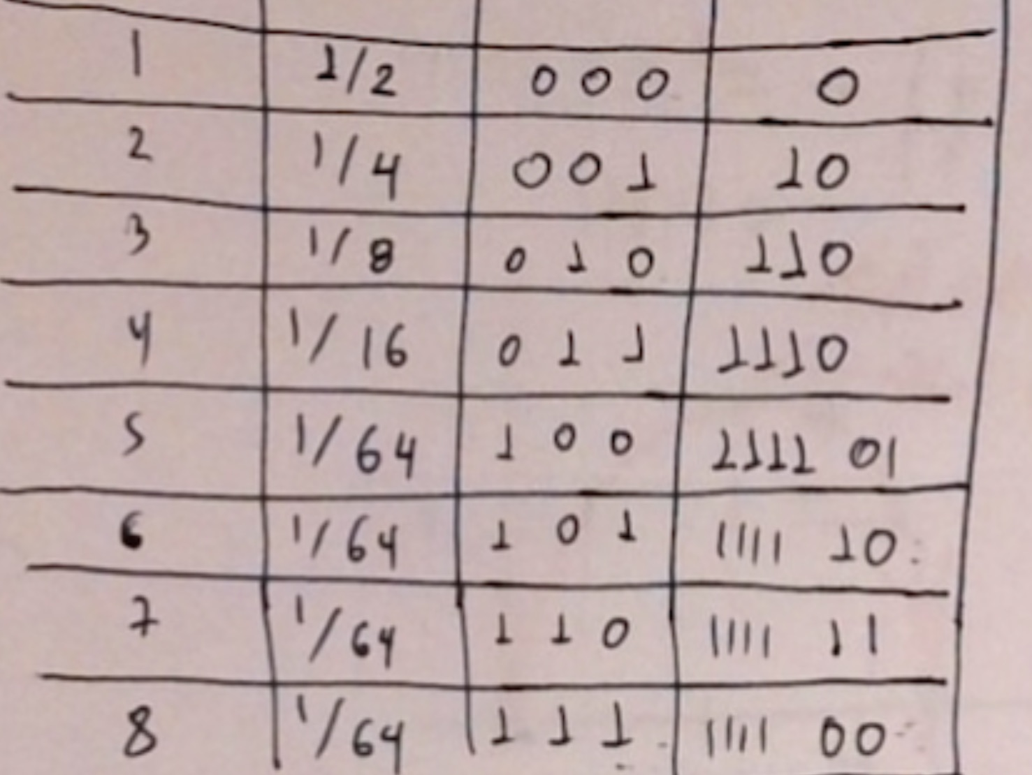
Horse race problem
Horse name.
Probability
Naïve code

Slide 16
Horse race problem
Horse name.
Probability
Naïve code

Slide 17
More details: Entropy and Information theory
How to compute entropy from distributions and datasets.
What is KL Divergence and Cross Entropy
Link between Cross Entropy, KL Divergence and Entropy

Slide 18
Entropy
Entropy definition
Example:
Random Variable 1: Fair Coin

Slide 19
KL Divergence and Cross Entropy
Kullback-Leibler Divergence
D(p ∥ q)
Example:
Random Variable 1: Fair Coin
H(p)=?
H(q)=?
Random Variable 2: Deterministic
Q: Compute KL Divergence between p and q

Slide 20
KL Divergence and Cross Entropy
Kullback-Leibler Divergence
Example:
Random Variable 1: Fair Coin
H(p)=?
H(q)=?
Random Variable 2: Deterministic
Q: Compute KL Divergence between p and q

Slide 21
KL Divergence and Cross Entropy
Kullback-Leibler Divergence
Example:
Random Variable 1: Fair Coin
H(p)=?
H(q)=?
Random Variable 2: Deterministic
Q: Compute KL Divergence between p and q

Slide 22
KL Divergence and Cross Entropy
Kullback-Leibler Divergence
Example:
Random Variable 1: Fair Coin
H(p)=?
H(q)=?
Random Variable 2: Deterministic
Q: Compute KL Divergence between p and q

Slide 23
KL Divergence and Cross Entropy
For two distributions (PMFs) p,q:
Cross Entropy

Slide 24
KL Divergence and Cross Entropy
For two distributions (PMFs) p,q:
Cross Entropy

Slide 25
KL Divergence and Cross Entropy
For two distributions (PMFs) p,q:
Cross Entropy
Sanity check
H(p,p)=?

Slide 26
KL Divergence and Cross Entropy
For two distributions (PMFs) p,q:
Cross Entropy
Sanity check
H(p,p)=H(p)

Slide 27
Lets tie KL Divergence and Cross Entropy together
Recall

Slide 28


Lets tie KL Divergence and Cross Entropy together
Recall
Total # of bits needed to describe a RV with distribution p, if your compression scheme was designed for q
Extra # of bits wasted because you used q for p
Total # of bits needed to compress a RV with distribution p

Slide 29
Lets tie KL Divergence and Cross Entropy together
Recall

Slide 30
Linking KL and Cross entropy example
Recall
Link: H(p,q)= D(p ∥ q)+H(p)
H(p,q)=?
D(p ∥ q)=?
H(p)=?

Slide 31
Linking KL and Cross entropy example
Recall
Link: H(p,q)= D(p ∥ q)+H(p)
You cannot compress p using a scheme for q!
H(p,q)= ∞
D(p ∥ q)= ∞
H(p)=1
Total # of bits needed to describe a RV with distribution p, if your compression scheme was designed for q
Extra # of bits wasted because you used q for p
Total # of bits needed to compress a RV with distribution p

Slide 32
Linking KL and Cross entropy example
Recall
Link: H(p,q)= D(p ∥ q)+H(p)
H(p,q)= ∞
D(p ∥ q)= ∞
H(p)=1
Total # of bits needed to describe a RV with distribution p, if your compression scheme was designed for q
Extra # of bits wasted because you used q for p
Total # of bits needed to compress a RV with distribution p

Slide 33
Linking KL and Cross entropy example
Recall
Link: H(q,p)= D(q ∥ p)+H(q)
H(q,p)= ?
D(q ∥ p)= ?
H(q)=?
Total # of bits needed to describe a RV with distribution p, if your compression scheme was designed for q
Extra # of bits wasted because you used q for p
Total # of bits needed to compress a RV with distribution p

Slide 34
Linking KL and Cross entropy example
Recall
Link: H(q,p)= D(q ∥ p)+H(q)
H(q,p)= 1
D(q ∥ p)= 1
H(q)=0
Total # of bits needed to describe a RV with distribution p, if your compression scheme was designed for q
Extra # of bits wasted because you used q for p
Total # of bits needed to compress a RV with distribution p

Slide 35
Recap
We learned the definitions of KL Divergence, Entropy and Cross Entropy.
How to compute them for simple distributions
Their connection H(p,q)= D(p ∥ q)+H(p)
Next thing we will learn: Cross entropy will be the loss we use for logistic regression and deep learning.

Slide 36
How to compute the entropy of English
There are 26 letters + space, so how many bits per letter?
Log 27 = 4.75 bits per English letter.
B*t th* En*l*sh l*ng***e i* c*mpre*sib*e (44 characters, only 32 given )
If we can make a generative model for English, we can use it for
-Generating fake English text
-Denoising
-Compressing
-Classification
-Break cryptographic codes

Slide 37
How to generate English, zero-th order letters
Pick randomly one letter from 27, uniformly
X
F
O
M
L
Space
R
XFOML RXKHRJFFJUJ ZLPWCFWKCYJ FFJEYVKCC

Slide 38
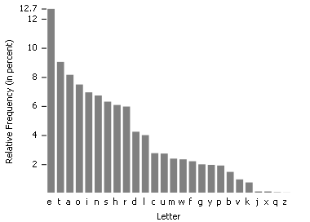
How to generate English, First order letters (match letter marginal distribution)
Pick randomly one letter from 27, using marginal
O
C
R
O
(space)
OCRO HLI RGWR NMIELWIS EU LL NBNESEBYA TH EEI ALHENHTTPA OOBTTVA NAH BRL

Slide 39
How to generate English, Second order Digrams (match letter conditional distribution)
Pick randomly one letter from 27, using marginal
O
Pick second letter from prob ( Letter 2 | letter 1 = O).
Histogram of which letter follows O
Exercise:
Given this dataset, compute the marginals for O,N,B Compute Pr(letter n/ letter n-1=O).
ON THE ONSET OF BOB

Slide 40
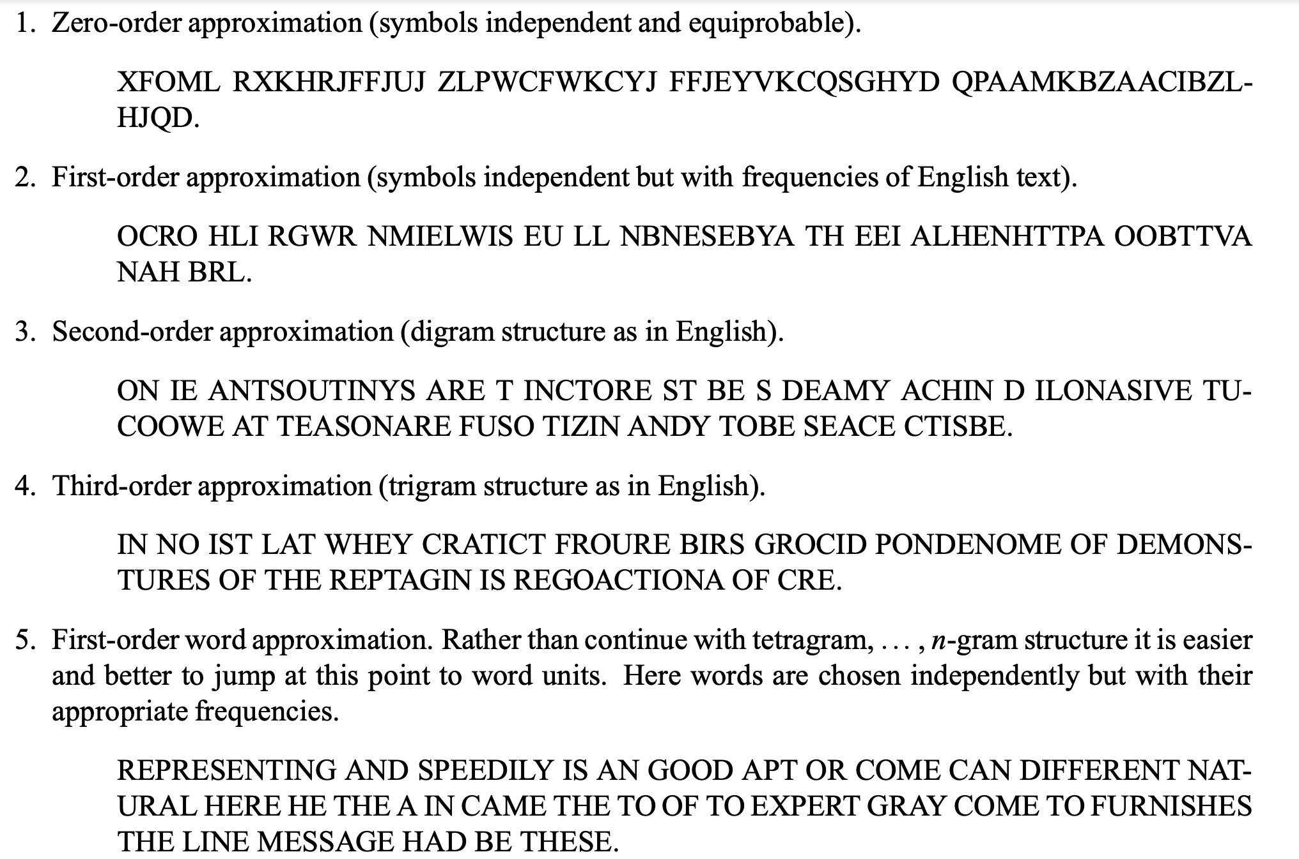
From Shannon’s 1948 paper, ‘A mathematical Theory of Communication”

Slide 41
How to tackle extra credit
Use pre-trained text generative models, e.g. as those hosted by Huggingface
See e.g. this blog post
https://huggingface.co/blog/how-to-generate

